Slide 1






Dr. Bhuvaneswari

Slide 2


Why is web crawler required?
How does web crawler work?
·
Crawling strategies
Breadth first search traversal depth first search traversal
Architecture of web crawler
Crawling policies
Distributed crawling

Slide 3


The process or program used by search engines to download pages from the web for later processing by a search engine that will index the downloaded pages to provide fast searches.
A program or automated script which browses the World Wide Web in a methodical, automated manner
also known as web spiders and web robots.
less used names- ants, bots and worms.

Slide 4




What is a web crawler?
How does web crawler work?
Crawling strategies
Breadth first search traversal depth first search traversal
Architecture of web crawler
Crawling policies
Distributed crawling

Slide 5
Beginning
A key motivation for designing Web crawlers has been to retrieve Web pages and add their representations to a local repository.

Slide 6
What is the “Web Crawling”?
What are the uses of Web Crawling? How API are used ?

Slide 7
Web Crawling: -
A Web crawler (also known as a Web spider, Web robot, or—especially in the FOAF community—Web scutter) is a program or automated script that browses the World Wide Web in a
methodical
automated manner.
Other less frequently used names for Web crawlers are ants, automatic indexers, bots, and worms.

Slide 8
What the Crawlers are:-
Crawlers are computer programs that roam the Web with the goal of automating specific tasks related to the Web.
The role of Crawlers is to collect Web Content.

Slide 9
Basic crawler operation:-
Begin with known “seed” pages
Fetch and parse them
Extract URLs they point to
Place the extracted URLs on a Queue
Fetch each URL on the queue and repeat

Slide 10



Traditional Web Crawler
Init
Seed URLs
Web
Download resource
Visited URLs
Repo
Extract URLs
Frontier
HT'06
7

Slide 11
Beginning with Web Crawler:
The basic Algorithm :
{
Pick up the next URL Connect to the server GET the URL
When the page arrives, get its links
(optionally do other stuff)
REPEAT
}

Slide 12
Uses for crawling:-
Complete web search engine
Search Engine = Crawler + Indexer/Searcher /(Lucene)
+ GUI
Find stuff
Gather stuff
Check stuff

Slide 13
Several Types of Crawlers:
Batch Crawlers- Crawl a snapshot of their crawl space, until reaching a certain size or time limit.
Incremental Crawlers- Continuously crawl their crawl space, revisiting URL to ensure freshness.
Focused Crawlers- Attempt to crawl pages pertaining to some topic/theme, while minimizing number of off topic pages that are collected.

Slide 14
Examples of Web crawlers
RBSE
World Wide Web Worm
Google Crawler
WebFountain
WebRACE

Slide 15

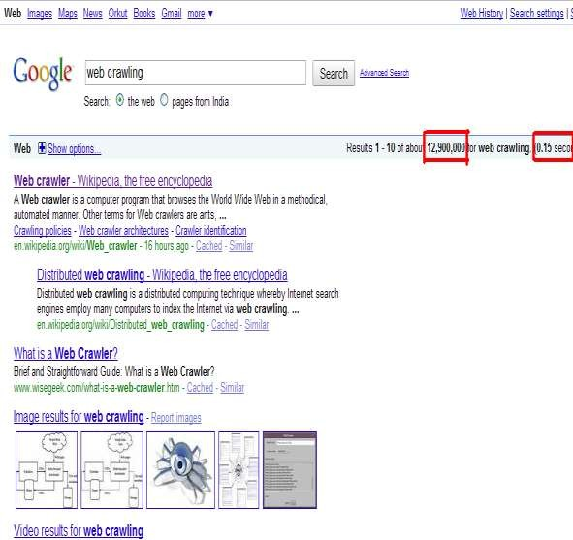
Internet has a wide expanse of Information.
Finding relevant information requires an efficient mechanism.
Web Crawlers provide that scope to the search engine.

Slide 16



· What is a web crawler?
Why is web crawler required?
How does web crawler work?
Crawling strategies
Breadth first search traversal depth first search traversal
Architecture of web crawler
Crawling policies
Distributed crawling

Slide 17



It starts with a list of URLs to visit, called the seeds . As the crawler visits these URLs, it identifies all the hyperlinks in the page and adds them to the list of visited URLs, called the crawl frontier
URLs from the frontier are recursively visited according to a set of policies.

Slide 18
Basic crawler operation
Sec. 20.2
Begin with known “seed” URLs
Fetch and parse them
Extract URLs they point to
Place the extracted URLs on a queue
Fetch each URL on the queue and repeat

Slide 19
Crawling picture
Sec. 20.2
URLs crawled
and parsed
Unseen Web
Seed
pages
URLs frontier
Web

Slide 20



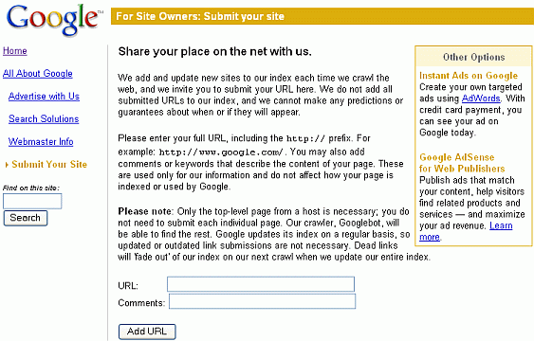




New url’s can be specified here. This is google’s web Crawler.

Slide 21

Initialize queue (Q) with initial set of known URL’s. Until Q empty or page or time limit exhausted:
Pop URL, L, from front of Q.
If L is not an HTML page (.gif, .jpeg, .ps, .pdf, .ppt…) exit loop.
If already visited L, continue loop(get next url).
Download page, P, for L.
If cannot download P (e.g. 404 error, robot excluded) exit loop, else.
Index P (e.g. add to inverted index or store cached copy).
Parse P to obtain list of new links N.
Append N to the end of Q.

Slide 22




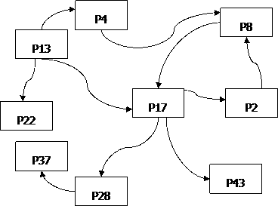

Slide 23

· What is a web crawler?
Why is web crawler required?
How does web crawler work?
Crawling strategies
Breadth first search traversal
depth first search traversal
Architecture of web crawler
Crawling policies
Distributed crawling

Slide 24


Alternate way of looking at the problem.
Web is a huge directed graph, with documents as vertices and hyperlinks as edges.
Need to explore the graph using a suitable graph traversal algorithm.
W.r.t. previous ex: nodes are represented by rectangles and directed edges are drawn as arrows.

Slide 25

Given any graph and a set of seeds at which to start, the graph can be traversed using the algorithm
Put all the given seeds into the queue;
Prepare to keep a list of “visited” nodes (initially empty);
As long as the queue is not empty:
Remove the first node from the queue;
Append that node to the list of “visited” nodes
For each edge starting at that node:
If the node at the end of the edge already appears on the list of “visited” nodes or it is already in the queue, then do nothing more with that edge;
Otherwise, append the node at the end of the edge to the end of the queue.

Slide 26
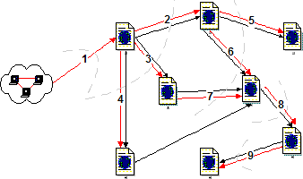

Slide 27

· What is a web crawler?
Why is web crawler required?
How does web crawler work?
Crawling strategies
Breadth first search traversal
Depth first search traversal
Architecture of web crawler
Crawling policies
Parallel crawling

Slide 28
Use depth first search (DFS) algorithm
Get the 1st link not visited from the start page
Visit link and get 1st non-visited link
Repeat above step till no non-visited links
Go to next non-visited link in the previous level and repeat 2nd step

Slide 29
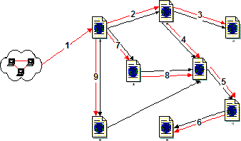

Slide 30



· depth-first goes off into one branch until it reaches a leaf node
not good if the goal node is on another branch
neither complete nor optimal
uses much less space than breadth-first
much fewer visited nodes to keep track of
smaller fringe
breadth-first is more careful by checking all alternatives
complete and optimal
very memory-intensive

Slide 31

· What is a web crawler?
Why is web crawler required?
How does web crawler work?
Crawling strategies
Breadth first search traversal Depth first search traversal
Architecture of web crawler
Crawling policies
Distributed crawling

Slide 32
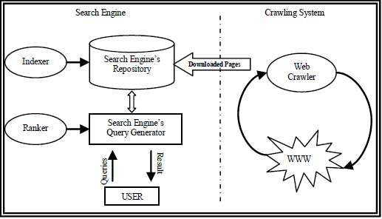

Slide 33

Doc
Fingerprint
Robots
templates
URL
set
www
DNS
Parse
Fetch
Content Seen?
URL
Filter
Dup URL
Elim
URL Frontier

Slide 34

URL Frontier: containing URLs yet to be fetches in the current crawl. At first, a seed set is stored in URL Frontier, and a crawler begins by taking a URL from the seed set.
DNS: domain name service resolution. Look up IP address for domain names.
Fetch: generally use the http protocol to fetch the URL.
Parse: the page is parsed. Texts (images, videos, and etc.) and Links are extracted.
Content Seen?: test whether a web page with the same content has already been seen at another URL. Need to develop a way to measure the fingerprint of a web page.

Slide 35
URL Filter:
Whether the extracted URL should be excluded from the frontier (robots.txt).
URL should be normalized (relative encoding).
en.wikipedia.org/wiki/Main_Page
<a href="/wiki/Wikipedia:General_disclaimer" title="Wikipedia:General disclaimer">Disclaimers</a>
Dup URL Elim: the URL is checked for duplicate elimination.

Slide 36

· What is a web crawler?
Why is web crawler required?
How does web crawler work?
Crawling strategies
Breadth first search traversal Depth first search traversal
Architecture of web crawler
Crawling policies
Distributed crawling

Slide 37


Selection Policy that states which pages to
download.
Re-visit Policy that states when to check for changes to the pages.
Politeness Policy that states how to avoid
overloading Web sites.
Parallelization Policy that states how to coordinate distributed Web crawlers.

Slide 38

Search engines covers only a fraction of Internet.
This requires download of relevant pages, hence a
good selection policy is very important.
Common Selection policies: Restricting followed links Path-ascending crawling
Focused crawling Crawling the Deep Web

Slide 39


Web is dynamic; crawling takes a long time.
Cost factors play important role in crawling.
Freshness and Age- commonly used cost functions.
Objective of crawler- high average freshness; low average age of web pages.
Two re-visit policies: Uniform policy Proportional policy

Slide 40

Crawlers can have a crippling impact on the
overall performance of a site.
The costs of using Web crawlers include: Network resources
Server overload
Server/ router crashes Network and server disruption
A partial solution to these problems is the robots exclusion protocol.

Slide 41
· How to control those robots!
Web sites and pages can specify that robots should not crawl/index certain areas.
Two components:
Robots Exclusion Protocol (robots.txt): Site wide
specification of excluded directories.
Robots META Tag: Individual document tag to exclude indexing or following links.

Slide 42


· Site administrator puts a “robots.txt” file at the root of the host’s web directory.
http://www.ebay.com/robots.txt
http://www.cnn.com/robots.txt
http://clgiles.ist.psu.edu/robots.txt
File is a list of excluded directories for a given robot (user-agent).
○ Exclude all robots from the entire site:
User-agent: * Disallow: /
New Allow:
Find some interesting robots.txt

Slide 43



· Exclude specific directories:
User-agent: * Disallow: /tmp/ Disallow: /cgi-bin/
Disallow: /users/paranoid/
Exclude a specific robot:
User-agent: GoogleBot Disallow: /
Allow a specific robot:
User-agent: GoogleBot Disallow:
User-agent: * Disallow: /

Slide 44


Only use blank lines to separate different User-agent disallowed directories.
One directory per “Disallow” line.
No regex (regular expression) patterns in directories.

Slide 45
The crawler runs multiple processes in parallel.
The goal is:
To maximize the download rate.
To minimize the overhead from parallelization. To avoid repeated downloads of the same page.
The crawling system requires a policy for assigning the new URLs discovered during the crawling process.

Slide 46

· What is a web crawler?
Why is web crawler required?
How does web crawler work?
Mechanism used
Breadth first search traversal Depth first search traversal
Architecture of web crawler
Crawling policies
Distributed crawling

Slide 47
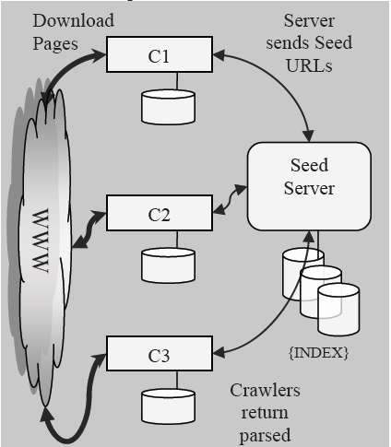

Slide 48


A distributed computing technique whereby search engines employ many computers to index the Internet via web crawling.
The idea is to spread out the required resources of computation and bandwidth to many computers and networks.
Types of distributed web crawling:
Dynamic Assignment
Static Assignment

Slide 49


With this, a central server assigns new URLs to different crawlers dynamically. This allows the central server dynamically balance the load of each crawler.
Configurations of crawling architectures with dynamic assignments:
A small crawler configuration, in which there is a central DNS resolver and central queues per Web site, and distributed down loaders.
A large crawler configuration, in which the DNS resolver and the queues are also distributed.

Slide 50


Here a fixed rule is stated from the beginning of the crawl that defines how to assign new URLs to the crawlers.
A hashing function can be used to transform URLs into a number that corresponds to the index of the corresponding crawling process.
To reduce the overhead due to the exchange of URLs between crawling processes, when links switch from one website to another, the exchange should be done in batch.

Slide 51


Focused crawling was first introduced by
Chakrabarti.
A focused crawler ideally would like to download only web pages that are relevant to a particular topic and avoid downloading all others.
It assumes that some labeled examples of relevant and not relevant pages are available.

Slide 52



A focused crawler predict the probability that a link to a particular page is relevant before actually downloading the page. A possible predictor is the anchor text of links.
In another approach, the relevance of a page is determined after downloading its content.
Relevant pages are sent to content indexing and their contained URLs are added to the crawl frontier; pages that fall below a relevance threshold are discarded.

Slide 53

Yahoo! Slurp: Yahoo Search crawler.
Msnbot: Microsoft's Bing web crawler.
Googlebot : Google’s web crawler.
WebCrawler : Used to build the first publicly- available full-text index of a subset of the Web.
World Wide Web Worm : Used to build a simple index of document titles and URLs.
Web Fountain: Distributed, modular crawler written in C++.
Slug: Semantic web crawler

Slide 54


Draw a neat labeled diagram to explain how does a web crawler work?
What is the function of crawler?
How does the crawler knows if it can crawl and index data from website? Explain.
Write a note on robot.txt.
Discuss the architecture of a search engine. 7)Explain difference between crawler and focused
crawler.

